Slide 1
Projects in RStudio
Getting R to figure out where the files are (directories) is key when reading in data from files
RStudio has projects which do this in a very slick manner
You can store different analyses in different projects and quickly switch between them
Each project has a separate set of .r files that are open, and a separate R workspace (saved objects in console)

Slide 2
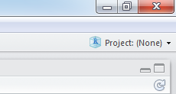
Using projects
Click on top-right option
Choose "Create Project" -> "Existing Directory" (or "New Directory" if a directory does not exist)
Select a directory, e.g. "Lectures" for me
The project will be saved as a file in that directory called "Lectures.Rproj"
Opening that will open the RStudio project
Automatically sets the R working directory to that directory

Slide 3
Reading in data
There are three oft-used functions
scan()
Most primitive, most flexible since it reads into a vector, and very fast, use for large or very messy data
read.table()
Easiest to use, reads into a data frame
read.csv()
Most useful for reading in Excel worksheets or other comma-separated data

Slide 4
Manual entry of data
Nearly always data are read in from a text file like .csv, but data can be entered manually from the keyboard
> co2 <- scan()
1: 316
2: 316.91
3: 317.63
4: 318.46
5:
Read 4 items
> co2
[1] 316.00 316.91 317.63 318.46

Slide 5
Reading in data from a file
read.table() has a number of common options (useful defaults listed below)
header=T first row has names for columns
sep=" " how are entries separated (white space)
na.strings=NA which values are treated as NAs
skip=0 the number of lines to skip before reading in data
nrows=-1 number of lines of data to read (-1 means all)
col.names=c("a","b") names for columns

Slide 6
Good format data file
Download file "dat_df1.dat" from "files/data files"
Copy this to the project directory or a subdirectory called "\Data"
read.table(file="Data\\dat_df1.dat", header=T)
read.table(file="Data/dat_df1.dat", header=T)
read.table(file="C:\\Data\\dat_df1.dat", header=T)
read.table("http:/courses.washington.edu/fish552/data/dat_df1.dat", header=TRUE)
Need double backslash for directories
Or a single forward slash
Use the full directory path
You can download data from a website, but better to save the data on your computer

Slide 7
No column names
Read in "data_df2.dat" which is missing column names
> read.table(file="Data/dat_df2.dat")
V1 V2 V3
1 31 12 M
2 62 18 F
...
> read.table(file="Data/dat_df2.dat",
col.names=c("id","age","sex"))
id age sex
1 31 12 M
2 62 18 F
...

Slide 8
Comments preceding data are ignored
Read in "data_df3.dat" which has comments in the data file before the data
# Comments can precede the data
# Fake patient data
id age sex
31 12 M
...
> read.table(file="Data/dat_df3.dat", header=T)
id age sex
1 31 12 M
2 62 18 F
...

Slide 9
Omit part of data file
File "dat_df4.dat" has comments not preceded by #
> read.table(file="Data/dat_df4.dat", header=T)
Error in scan(file, what, nmax, sep, dec, quote, skip, nlines, na.strings, :
line 1 did not have 8 elements
> read.table(file="Data/dat_df4.dat", header=T, skip=3)
id age sex
1 31 12 M
2 62 18 F
...

Slide 10
Data not separated by white space
Read in "dat_df5.dat"
> read.table(file="Data/dat_df5.dat", sep="/", header=T)
id age sex
1 31 12 M
2 62 18 F
...
Read in .csv file with commas
> read.table(file="Data/dat_df1.csv", sep=",", header=T)

Slide 11
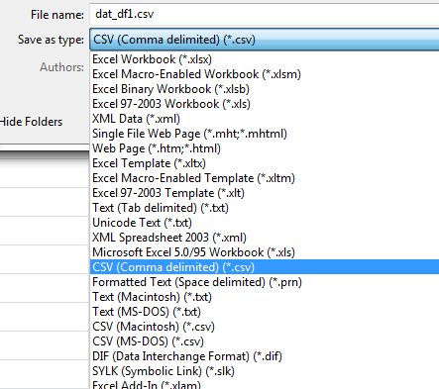
Data from Excel
Open fresh Excel workbook, single sheet, paste your data as values only, save as "Comma delimited (*.csv)"
Read the data in using read.csv()
> read.csv(file="Data/dat_df1.csv", header=T)
id age sex
1 31 12 M
2 62 18 F
3 50 20 F

Slide 12
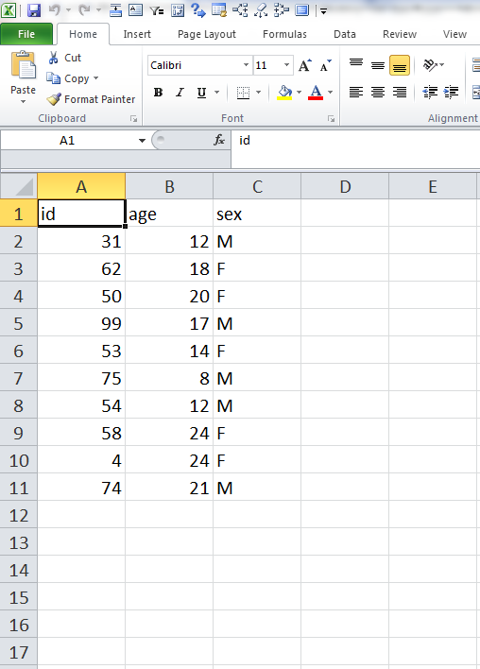
Excel sheet problems
All columns to the right and rows below should be empty and always have been empty hence the need for an empty sheet
Data should start in the top left corner
Or delete all rows below and all columns to the right in Excel before saving as .csv

Slide 13
Reading in as text not factors
Most often I am using a database where I want the text to be text, and not factors
> x <- read.csv(file="Data/dat_df1.csv", header=T)
> x$sex
[1] M F F M F M M F F M
Levels: F M
> x <- read.csv(file="Data/dat_df1.csv", header=T,
+ stringsAsFactors=F)
> x$sex
[1] "M" "F" "F" "M" "F" "M" "M" "F" "F" "M"
stringsAsFactors controls how text is read in

